Slide 1


Domain Generalization

Slide 2

Task
Our task: comparing with baseline, to see
whether and how will the domain numbers、poisoned data’s
number(and so on) effect the accurate
Generalization: Only training dataset can be used , getting a mode to minimize risk or error in testing dataset
Problem: domain shift、different distribution
covariance shift

Slide 3
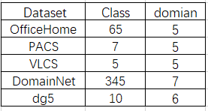
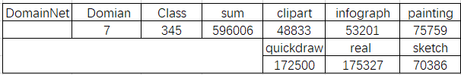
Dataset
PACS
DomianNet
①: Fine-grained images are not required(Semantic segmentation)
②: Most images are used for recognition

Slide 4
Method
Adjust algorithms’ hyperparameter
Baseline: ERM
Control attack domain、poisoned data proportion
A data augmentation、proposes a mixed distribution ，making the model behave as less complex as possible
01
Mixup
The algorithms we used
02
Focus on the shift between the source domain and the training domain , then minimize it
MMD
High-level pruning (Dropout) acts on the last layer, based on gradient sorting in order to discard some features
03
RCS

Slide 5
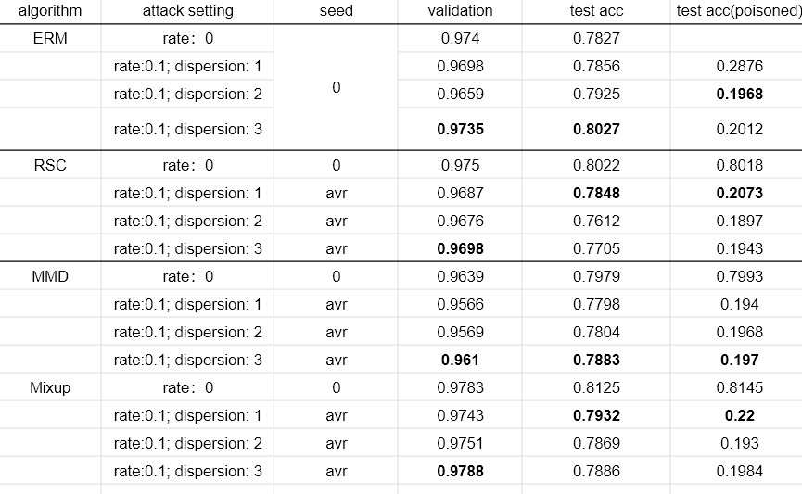
Outcome(On PACS)

Slide 6
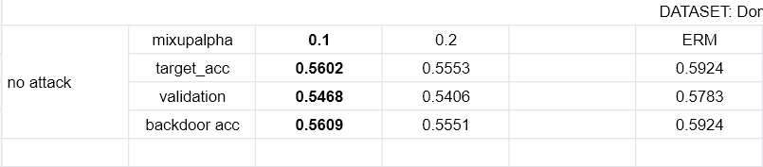
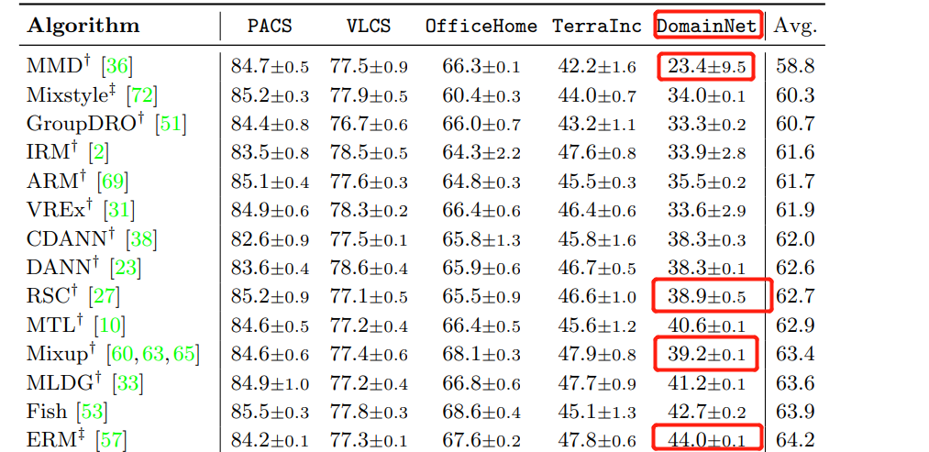
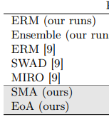
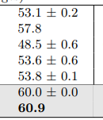
Outcome(On DomianNet)

Slide 7
Thanks

Slide 8
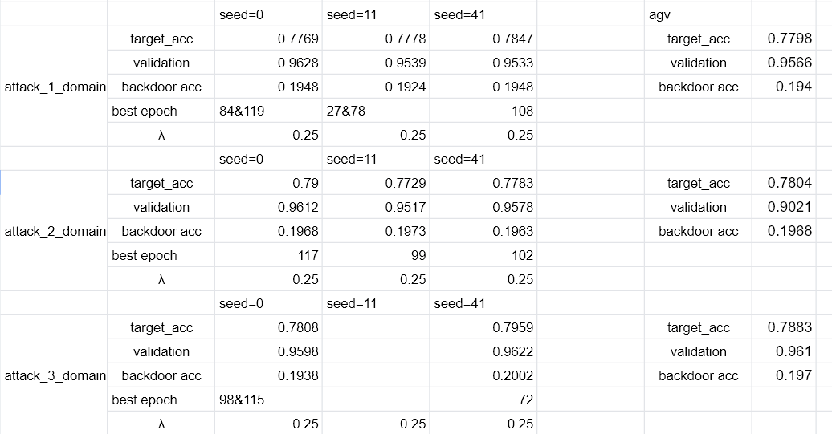
Outcome(MMD)

Slide 9
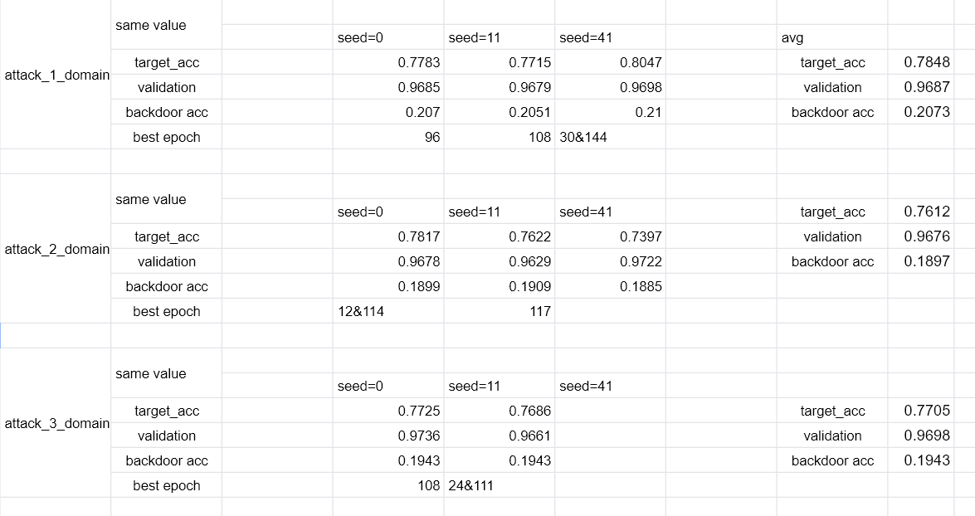
Outcome(RCS)

Slide 10
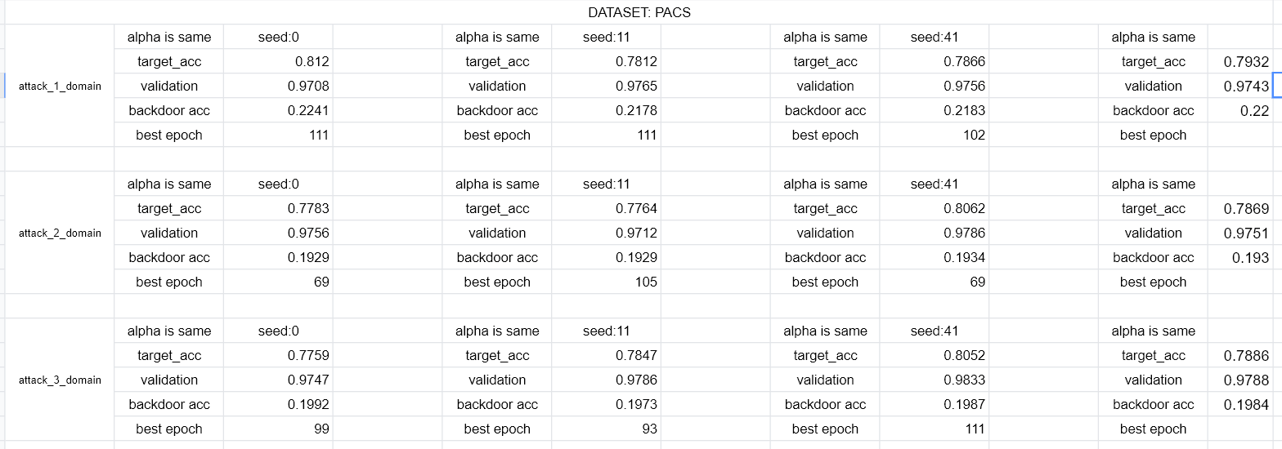
Outcome(Mixup)

